Slide 1
INTERNSHIP REVIEW II
Name :- Navin Vengal
PRN :- 202001103093
Class :- B.Tech CSE II
College Mentor :
Ms. Poonam R Mam

Slide 2
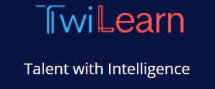
Company Details :-
Company Name:- TwiLearn EduTech Pvt. Ltd., Pune
Address:- Bhumkar Das Gugre Rd, Bhagwan Nagar, Bhumkar Nagar, Wakad, Pimpri-Chinchwad, Maharashtra 411057

Slide 3
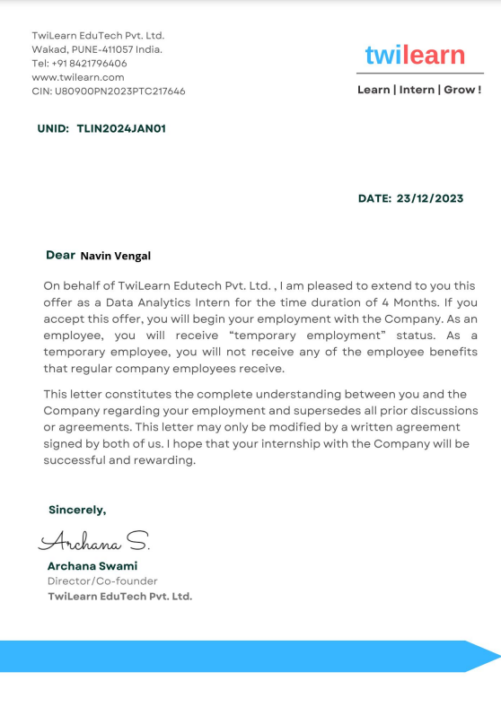
OFFER LETTER
Company Name :- Twilearn EduTech Pvt. Ltd. ,Pune
Mentor Details :- Onkar Mathapati
+91 9049760416

Slide 4
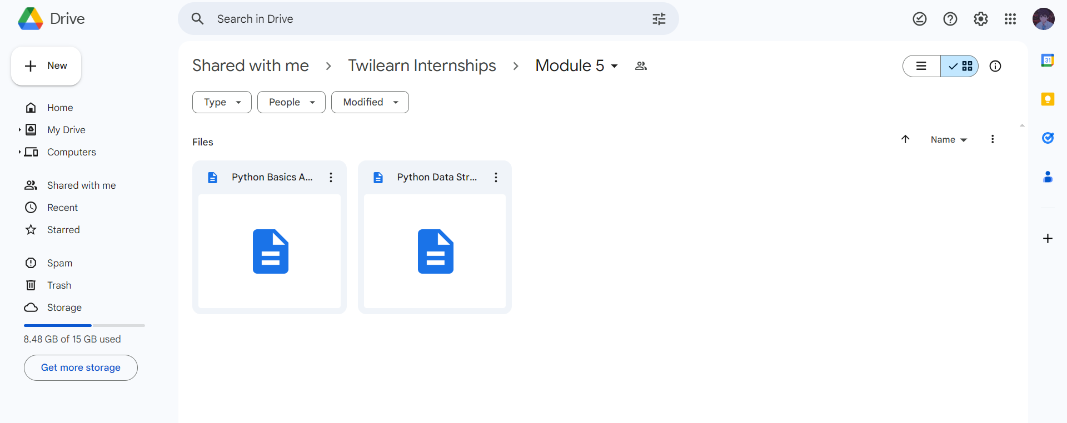
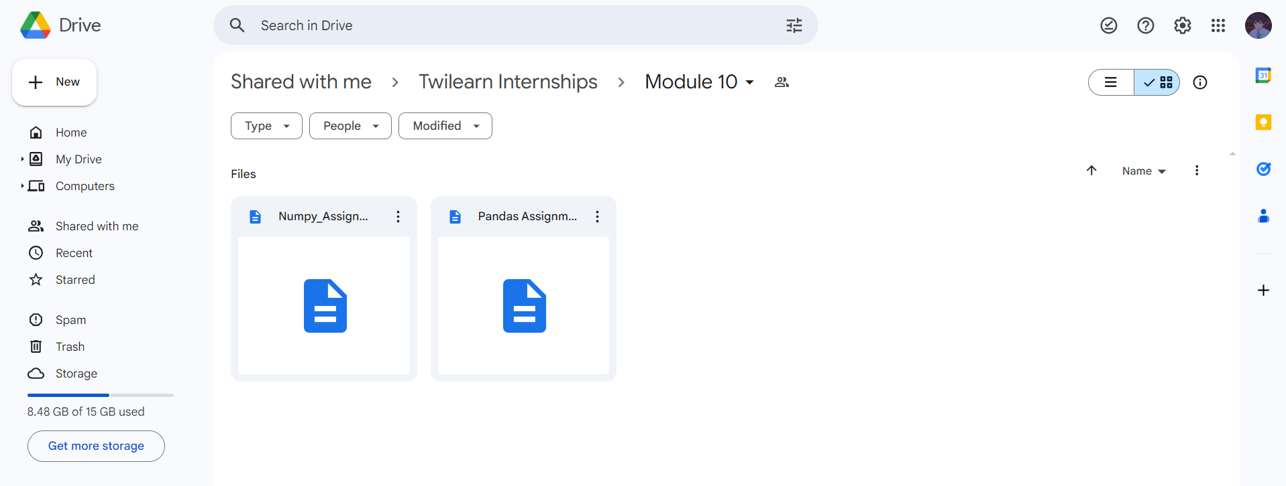
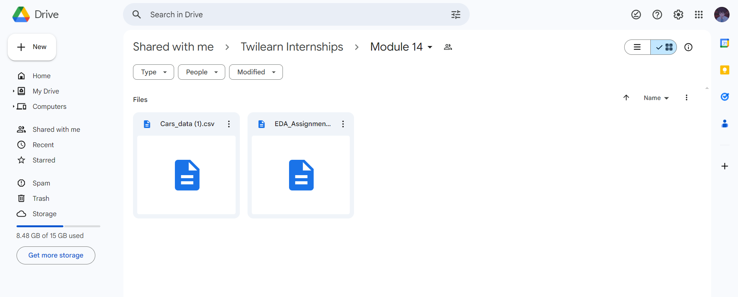
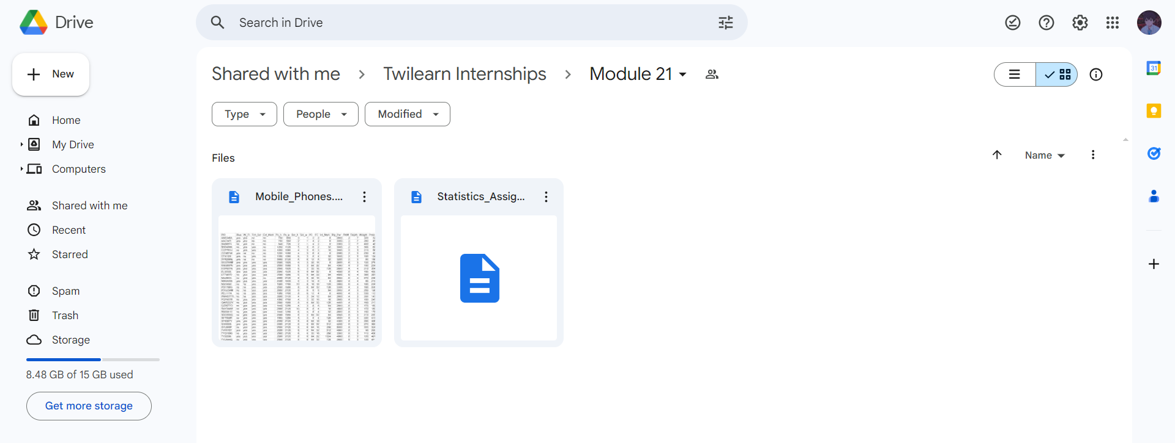
All Assignment Completed & Submitted

Slide 5
Week 9 ( 11-03-2024 – 23-03-2024)
Project 1 :- Airbnb Analysis
Project Work :-
Set up Project Environment
Study the Data Set
Perform the Basic Operations
Loading , Cleaning and Analyzing Data
Statistical Operation
Visualization
Dashboard

Slide 6
CONTENTS
Problem Statement
Introduction
Objective
Insights
Dashboard
Conclusion

Slide 7
Problem Statement:-

Slide 8
Introduction:-

Slide 9
Objective:-

Slide 10
Insights:-

Slide 16
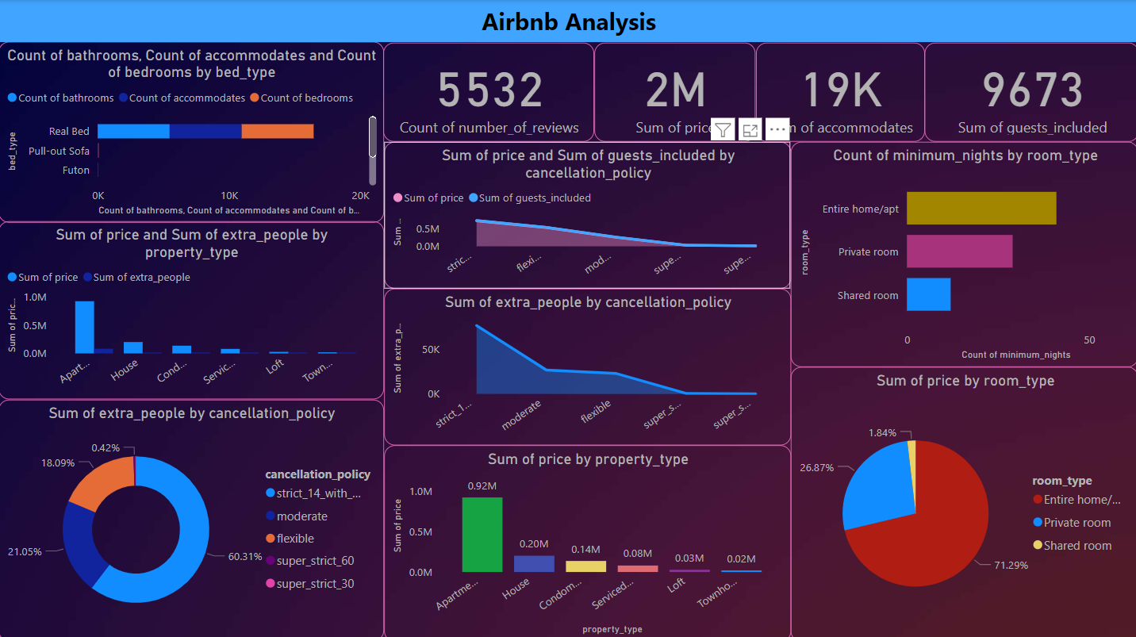
Dashboard :-

Slide 17
Conclusion :-

Slide 18
Week 10 (27-03-2024 – 15/04/2024)
Project 2 :- Employee Attrition Analysis
Problem Work :-
Set up Project Environment
Study the Data Set
Perform the Basic Operations
Loading , Cleaning and Analyzing Data
Visualization
Train and Test the Data
Dashboard

Slide 19
CONTENTS
Problem Statement
Introduction
Objective
Insights
Dashboard
Conclusion

Slide 20
Problem Statement :-
XYZ company which was established a few years back is facing around a 15% attrition rate for a couple of years. And it's majorly affecting the company in many aspects. In order to understand why employees are leaving the company and reduce the attrition rate
XYZ company has approached an HR analytics consultancy for analyzing the data they have. You are playing the HR analyst role in this project and building a dashboard which can help the organization in making data-driven decisions.

Slide 21
Introduction :-
Employee attrition analytics is specifically focused on identifying why employees voluntarily leave, what might have prevented them from leaving, and how we can use data to predict attrition risk. Most importantly, this type of employee predictive analytics can be used to help organizations understand and design the interventions that will be most effective in reducing unwanted attrition.

Slide 22
Objective :-
playing the HR analyst role in this project and building a dashboard which can help the organization in making data-driven decisions.

Slide 23
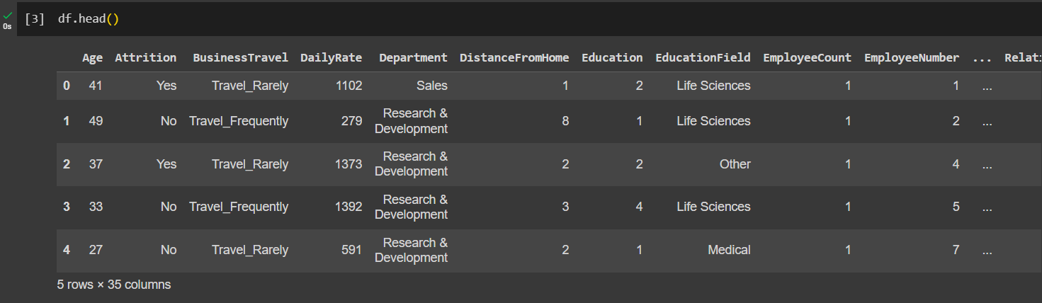
Insights from Analysis

Slide 24
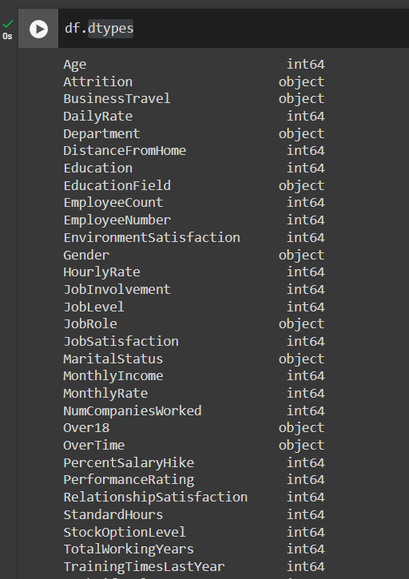
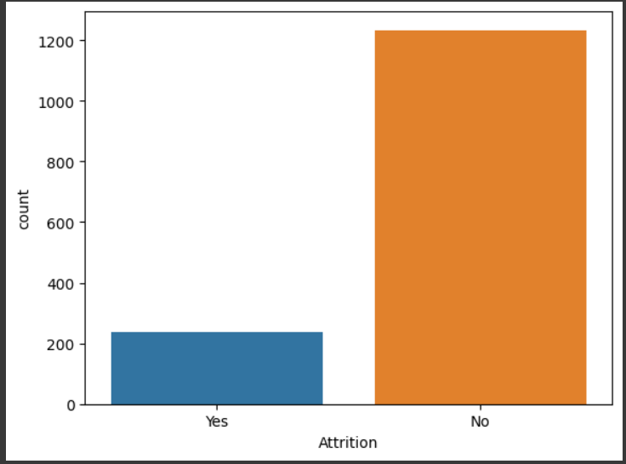
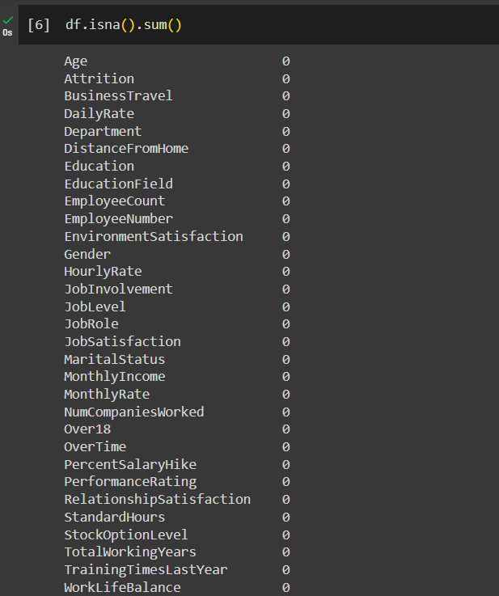

Slide 25
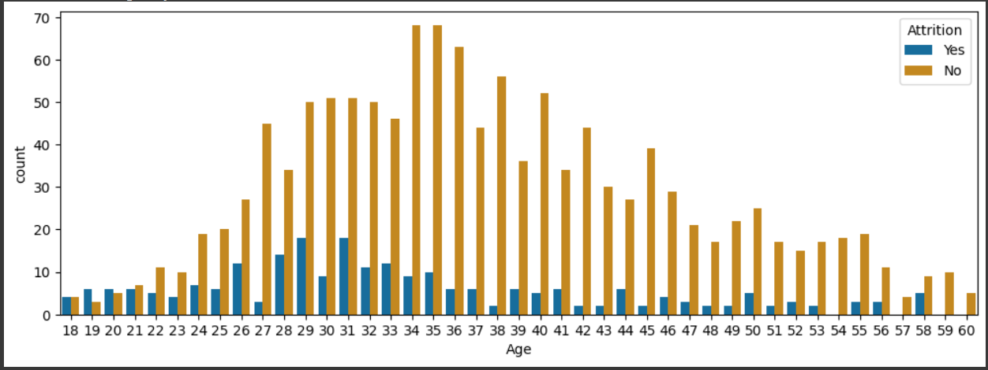

Slide 26
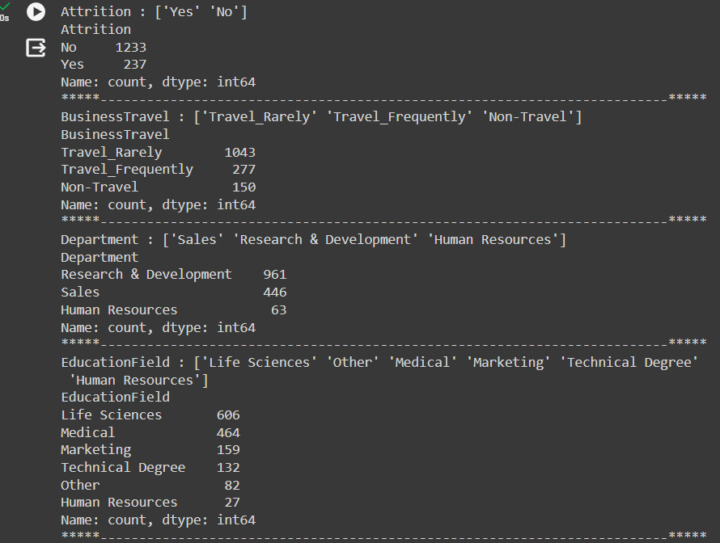
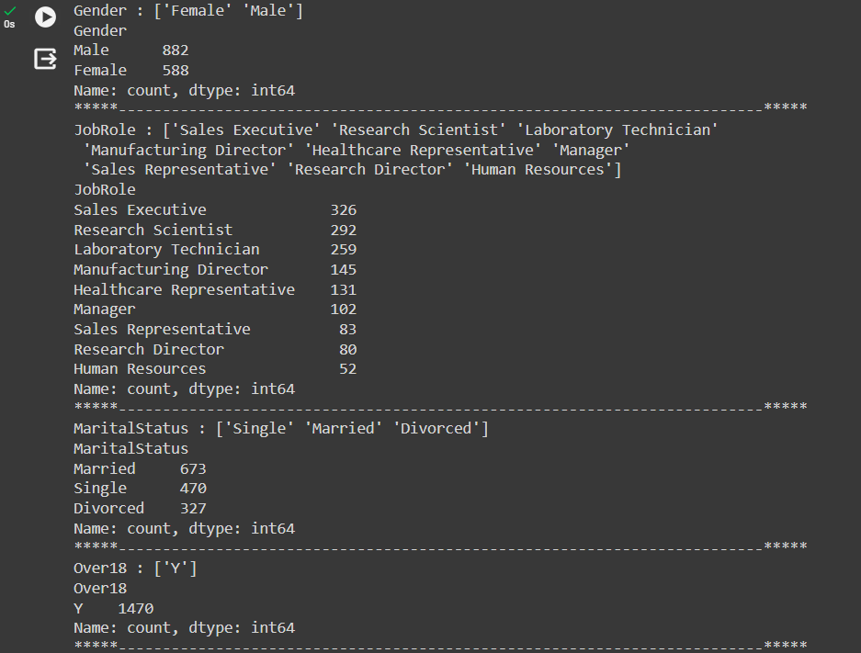

Slide 27
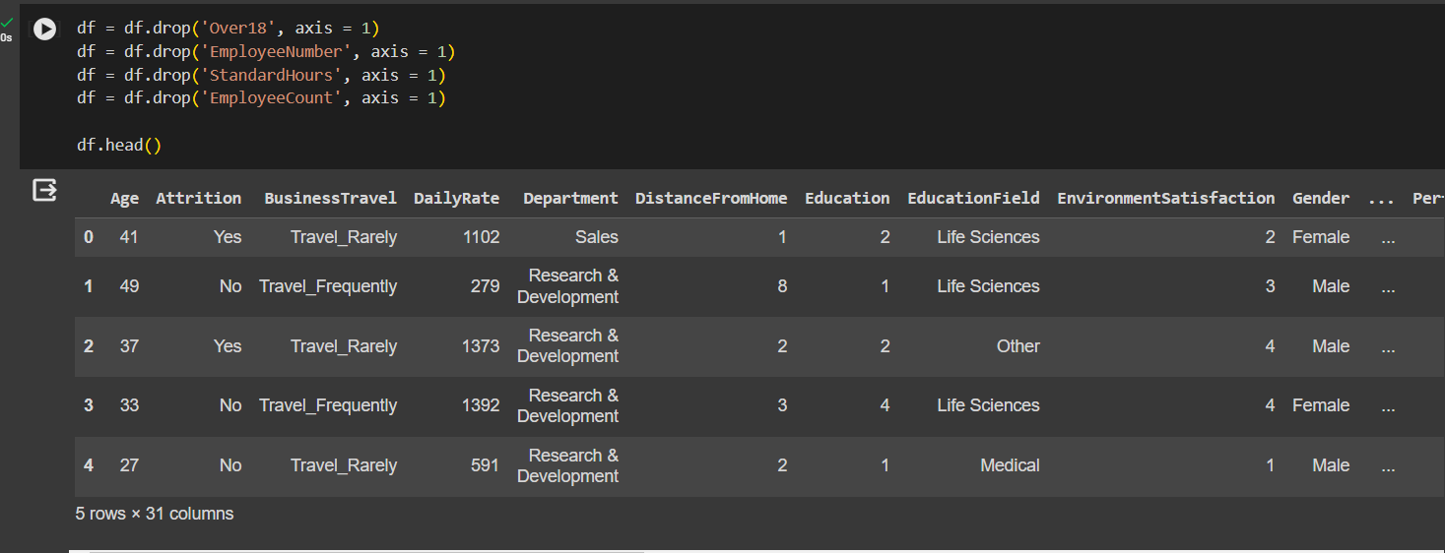

Slide 28
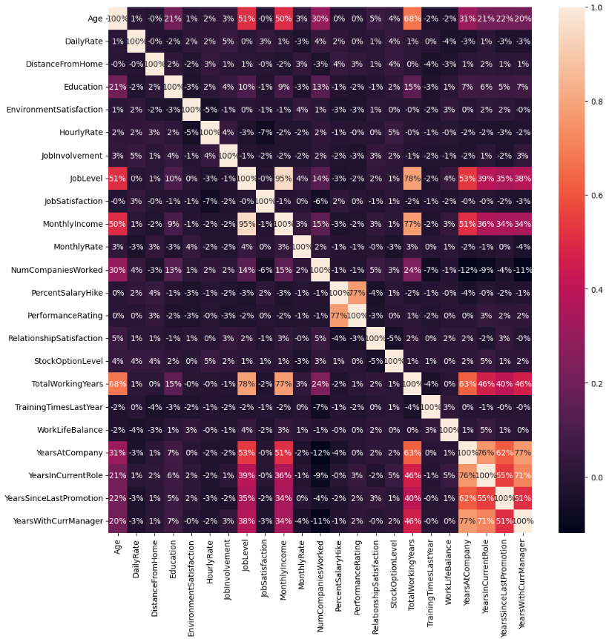

Slide 29
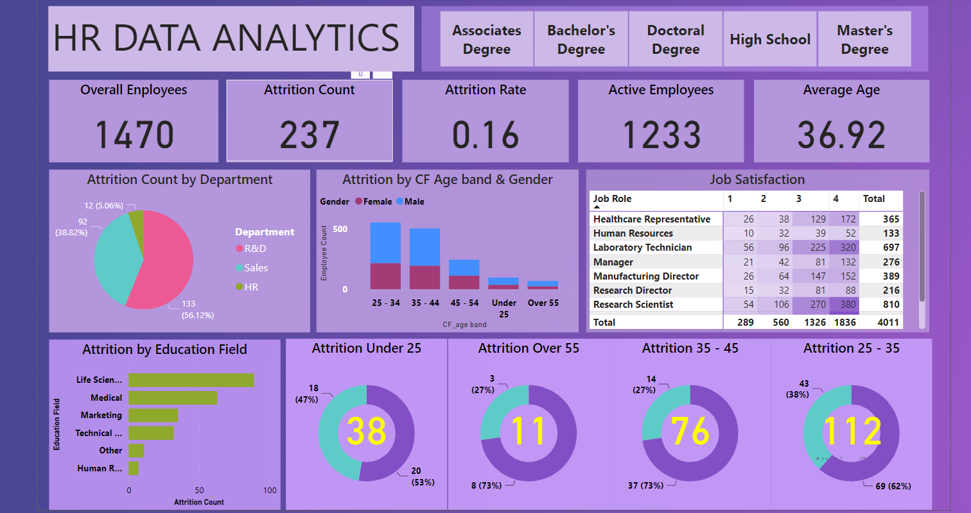
Dashboard :-

Slide 30
Conclusion :-

Slide 31
links

Slide 32
THANK YOU

